Slide 1

Bank Customer Churn Prediction using ANN
Toshi Mago
Academic/Technical Presentation

Slide 2
Business Problem Statement: Mitigating Customer Churn
Banks face significant financial losses due to customer churn, which occurs when a customer closes their account and ceases business with the institution. Proactive churn prediction enables targeted retention strategies.
Voluntary Churn
Involuntary Churn
Customers intentionally leave due to dissatisfaction with service, more attractive offers from competitors, or changing financial needs.
Account closures occur due to system issues, extended inactivity, or unforeseen external events (e.g., customer demise).
Our objective is to leverage Artificial Neural Networks (ANN) to predict the likelihood of individual customer churn, enabling early intervention.

Slide 3

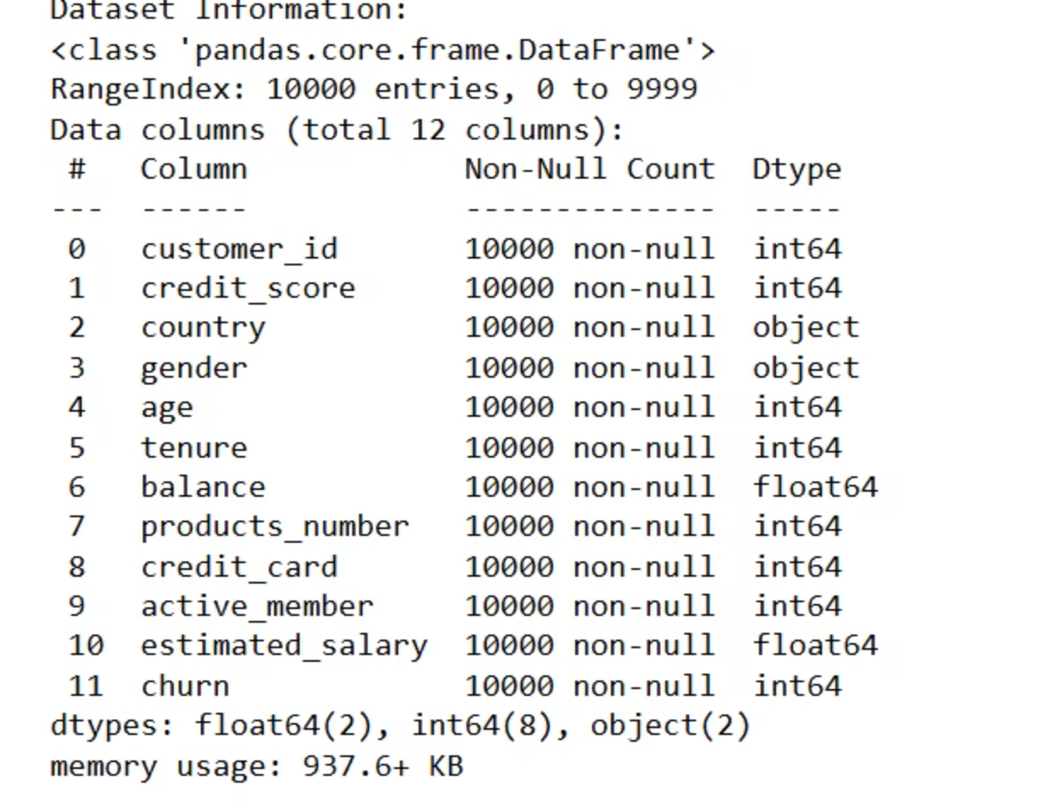
Dataset Overview
The dataset for this study is sourced from Kaggle: "Bank Customer Churn Prediction.csv".
Target variable: 'churn' (binary: 0 = No Churn, 1 = Churn).
Key Features: The dataset includes a rich set of customer attributes, such as credit score, geographical location, age, tenure with the bank, account balance, and the number of products utilized.

Slide 4
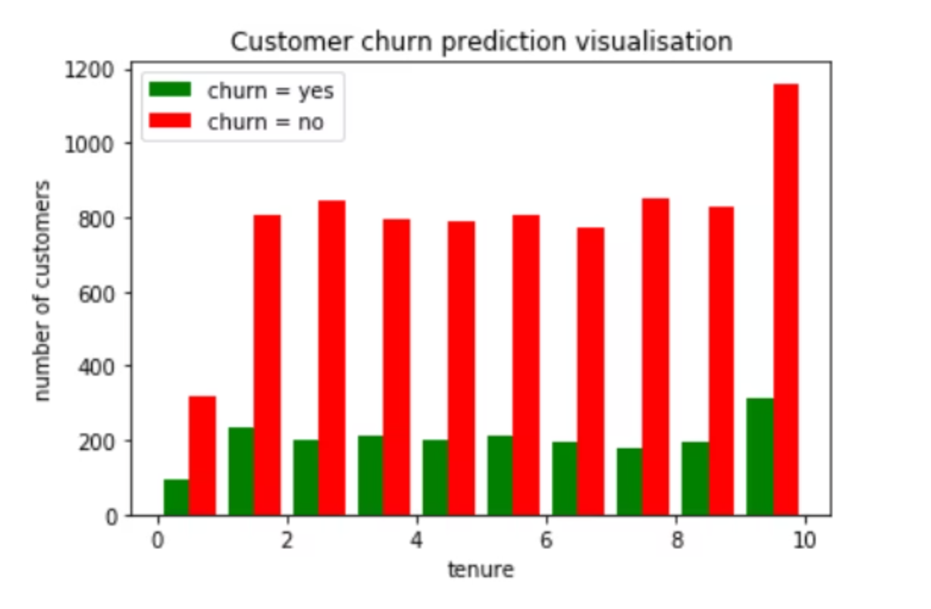
Exploratory Data Analysis: Churn by Tenure
Understanding the distribution of customer churn across different tenure periods provides crucial insights into retention challenges. This visualization displays the actual churn rates as a function of customer tenure within the dataset.
The Python code used is in this project name is Bank_Customer_churn_tensor_flow.ipynb

Slide 5

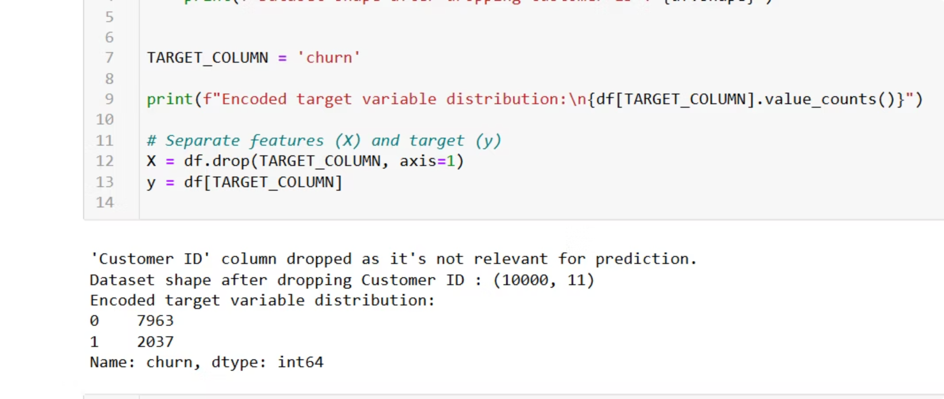
Initial Data Preparation: Feature Exclusion
Prior to model training, certain columns are excluded from the dataset to refine the feature set. Specifically, the 'customer_id' column is dropped as it serves purely as an identifier and holds no predictive power for churn.
Additionally, the 'churn' column, which represents our target variable, is separated and set aside. This ensures that the model is trained only on the input features and not inadvertently exposed to the target during feature engineering steps, preventing data leakage.

Slide 6
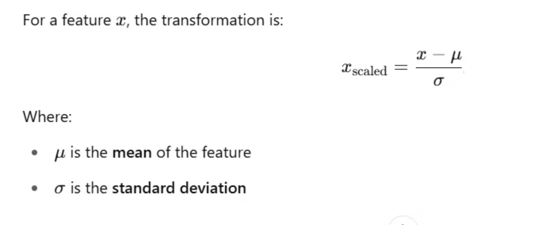
Data Preprocessing: Numerical Feature Scaling
Numerical features are scaled using StandardScaler from sklearn.preprocessing. This technique transforms data to have a mean of 0 and a standard deviation of 1. It is essential for ANNs.
Speeds up Convergence: Gradient descent algorithms converge faster when features are on a similar scale.
Balances Features: Prevents features with larger magnitudes from disproportionately influencing the model's learning process.
Activations: Standardized inputs improve the behavior of activation functions like ReLU and Sigmoid, especially around their linear regions, enhancing model training stability.

Slide 7



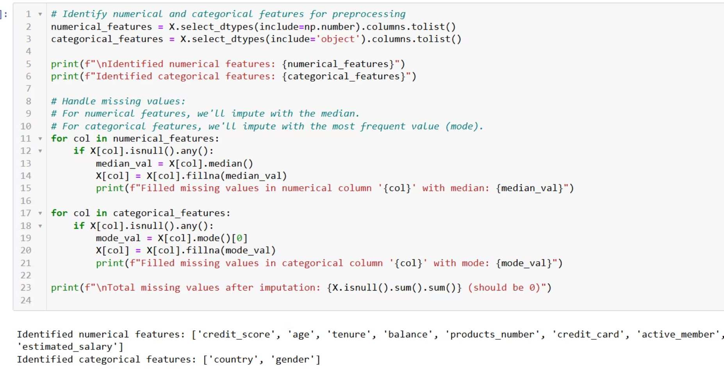
Data Preprocessing: Categorical Feature Encoding
Categorical features are converted into a numerical format using OneHotEncoder from sklearn.preprocessing. This is crucial for machine learning models, particularly ANNs, as they primarily operate on numerical data.
Binary Columns
No Order Implied
Model Compatibility
For each category within a feature, a new binary column (0 or 1) is created. A '1' indicates the presence of that category, while a '0' indicates its absence.
One-hot encoding is ideal when categories lack an inherent ordinal relationship (e.g., 'France' is not 'greater' than 'Germany'). This prevents the model from mistakenly inferring such relationships.
This conversion allows the ANN to process categorical data effectively, integrating it into its numerical computations without misinterpretations.

Slide 8
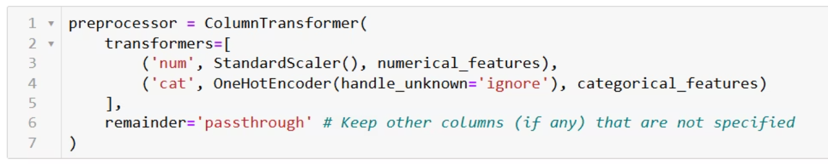
Integrated Preprocessing Pipeline with ColumnTransformer
To streamline and robustly apply both numerical scaling and categorical encoding, a ColumnTransformer is employed within a preprocessing pipeline.
Standard Scaling for Numerical Features: Applies StandardScaler specifically to all numerical columns, ensuring they are normalized for optimal ANN performance.
One-Hot Encoding for Categorical Features: Applies OneHotEncoder exclusively to categorical columns, converting them into a machine-readable binary format.
Pipeline Integrity: This integrated pipeline ensures that all preprocessing steps are applied consistently and correctly, providing a clean, structured, and appropriately transformed dataset ready for input into the Artificial Neural Network model.

Slide 9

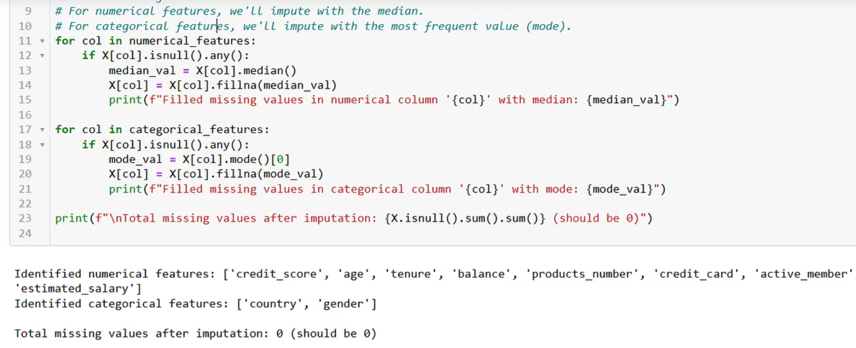
Missing Value Handling Strategy
Addressing missing data is a critical step in ensuring the integrity and performance of the churn prediction model. A systematic approach is adopted to impute missing values across both numerical and categorical features.
Numerical Features
For numerical features with identified missing values, the median imputation strategy is applied. The median is chosen over the mean to minimize the impact of potential outliers, preserving the distribution of the data.
1
Categorical Features
For categorical features, missing values are imputed using the mode (most frequent category). This approach maintains the overall distribution of categories and is robust against skewed distributions within the categorical data.
2

Slide 10
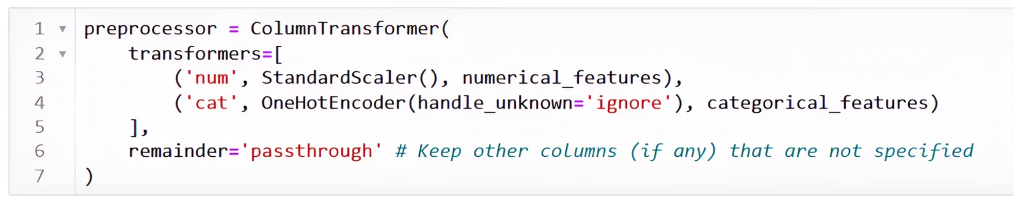
Streamlined Preprocessing Pipeline
A ColumnTransformer orchestrates the preprocessing steps, ensuring a robust and reproducible data transformation workflow for the ANN.
Numerical scaling
categorical scaling
Integrated output
StandardScaler is applied to all numerical features.
One-Hot Encoding is performed on all categorical features.
One-Hot Encoding is performed on all categorical features.

Slide 11
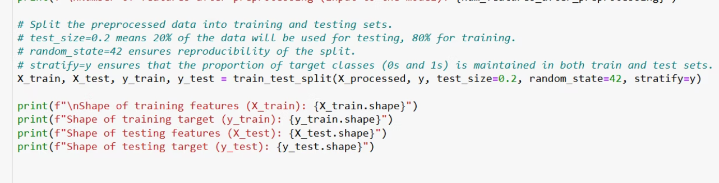
Data Splitting: Training and Testing Sets
To effectively evaluate the model's generalization capabilities and prevent overfitting, the preprocessed dataset is partitioned into distinct training and testing sets.
Training Data (80%): The majority of the dataset (80%) is allocated for training the Artificial Neural Network. This allows the model to learn the complex patterns and relationships within the features that contribute to customer churn.
Test Data (20%): The remaining 20% of the dataset is reserved as the unseen test set. This set is used exclusively for evaluating the trained model's performance on new, unobserved data, providing an unbiased assessment of its predictive accuracy.

Slide 12
Artificial Neural Networks and Weights
An artificial neural network (ANN) is a type of machine learning model inspired by the structure and function of the human brain. It is composed of interconnected nodes, called neurons, that transmit signals between each other. The connections between neurons have numeric weights that can be tuned during the training process to capture patterns in data.
The key components of an ANN are:
Neurons
Weights
Activation Function
The fundamental units that receive input, perform computations, and produce output.
Numeric values assigned to the connections between neurons that determine the strength of the signal transmitted.
A non-linear function that determines whether a neuron should be activated and what output signal it should produce.
The main benefit of ANNs is their ability to learn complex, non-linear relationships in data through the adjustment of neuron weights during training. This makes them well-suited for tasks like image recognition, natural language processing, and forecasting. As the network is exposed to more data, the weights are updated to improve the model's performance on the task at hand.

Slide 13




Understanding Artificial Neural Networks and Weights
The diagram shows the key components of an artificial neural network (ANN):
Input Layer
Hidden Layers
Output Layer
The input layer receives the data that the ANN will process, such as customer information or sensor readings.
The hidden layers perform the bulk of the computational work, applying an activation function to the weighted inputs to produce outputs that are passed to the next layer.
The output layer produces the final predictions or classifications from the ANN, such as whether a customer is likely to churn or not.
The connections between the neurons in each layer have associated weights, which are numeric values that determine the strength of the signal transmitted. During the training process, these weights are iteratively adjusted to minimize the error between the ANN's predictions and the true target values.
The activation function is a non-linear transformation applied to the weighted sum of a neuron's inputs. This allows the ANN to learn complex, non-linear relationships in the data. Common activation functions include the sigmoid, ReLU, and tanh functions.
As the ANN is exposed to more training data, the weights and biases are updated to improve the model's performance on the task at hand, making ANNs a powerful tool for machine learning and artificial intelligence applications.

Slide 14
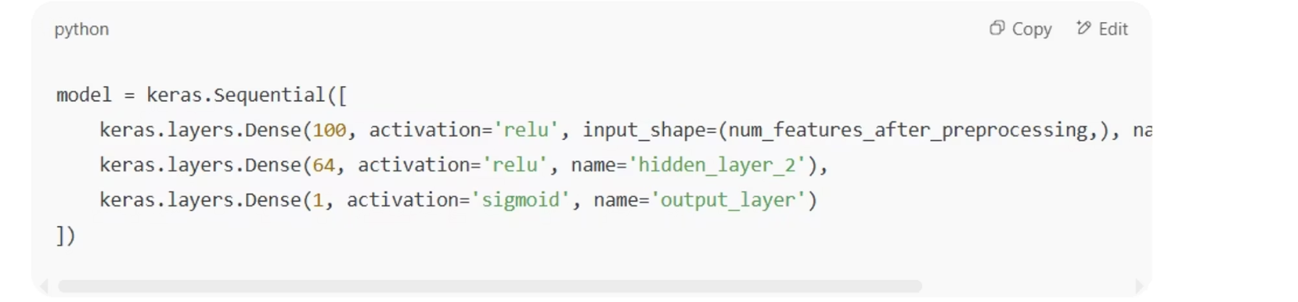
ANN ArchitectureANN Architecture
In my code this is how all the layers are defined
•Hidden Layer 1: 100 neurons, ReLU
•Input layer: Based on number of features
•Hidden Layer 2: 64 neurons, ReLU
•Output Layer: 1 neuron, Sigmoid
•Optimizer: Adam
•Loss: Binary Crossentropy
Check next slide to understand loss function, activation function and sigmoid

Slide 15

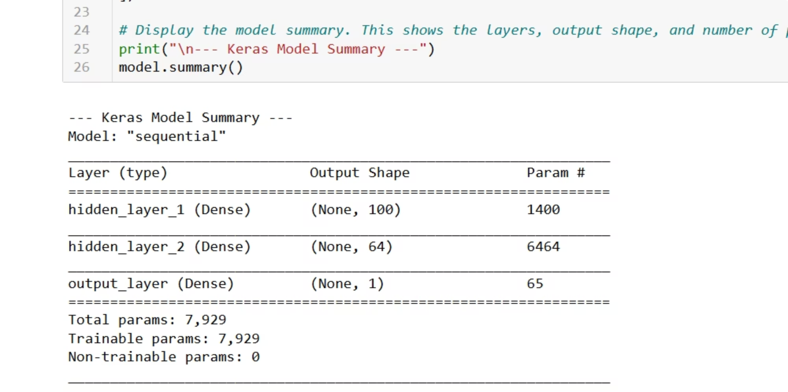
Model Summary
The total number of parameters in an artificial neural network (ANN) model can be calculated as follows:
Total Parameters = Trainable Parameters + Non-Trainable Parameters
Trainable parameters are the weights and biases that are updated during the training process using backpropagation. Non-trainable parameters are typically used for normalization or other fixed operations that do not change during training.
In the given model summary:
Number of hidden parameters in layer one: 1400
Total number of parameters: 7929
Trainable parameters: 7929
Non-trainable parameters: 0
This indicates that all 7929 parameters in the model are trainable, and there are no non-trainable parameters.

Slide 16
Activation Functions and Optimization
The artificial neural network (ANN) uses specific activation functions and optimization algorithms to improve its performance:
ReLU (Rectified Linear Unit)
Sigmoid
Adam Optimizer
ReLU is a popular activation function that applies the non-linear transformation f(x) = max(0, x) to the weighted sum of a neuron's inputs. ReLU is often used in the hidden layers of the ANN as it introduces non-linearity, allows for faster and more effective training, and helps prevent the vanishing gradient problem.
The sigmoid function, f(x) = 1 / (1 + e^(-x)), is commonly used as the activation function for the output layer of a binary classification problem, such as predicting customer churn. The sigmoid function maps any input value to a value between 0 and 1, which can be interpreted as the probability of the input belonging to the positive class.
Adam (Adaptive Moment Estimation) is an optimization algorithm that is often used to train the ANN model. Adam combines the benefits of two other optimization methods, AdaGrad and RMSProp, to provide an efficient and effective way to update the model's weights during the training process. Adam adapts the learning rate for each parameter based on the mean and uncentered variance of the gradients, which can lead to faster convergence and improved model performance.
Loss Function: Binary Cross-Entropy
For a binary classification problem like customer churn prediction, the ANN model is trained to minimize the binary cross-entropy loss function. This loss function measures the difference between the model's predicted probabilities and the true binary labels (0 or 1) for each sample. Minimizing this loss function encourages the model to output probabilities that are close to the true labels, improving the model's ability to make accurate predictions.
The binary cross-entropy loss is calculated as:L = -\frac{1}{N}\sum_{i=1}^{N}[y_i\log(p_i) + (1-y_i)\log(1-p_i)]
Where N is the number of samples, y_i is the true binary label (0 or 1), and p_i is the model's predicted probability for the positive class.

Slide 17
Forward Propagation
Forward propagation is the process of feeding the input data through the neural network layers to generate the output predictions. The mathematical formula for forward propagation in an artificial neural network is:
z = W * X + b
Where:
z is the weighted sum of the inputs
W is the weight matrix
X is the input vector
b is the bias vector
The output of the activation function applied to z is the input to the next layer.
Backpropagation
Backpropagation is the process of updating the weights and biases of the neural network based on the error between the predicted output and the true output. The mathematical formula for backpropagation is:
dW = (1/m) * X.T * dZ
db = (1/m) * np.sum(dZ, axis=1, keepdims=True)
Where:
dW is the gradient of the weights
db is the gradient of the biases
dZ is the error signal
m is the number of training examples
X.T is the transpose of the input matrix
The gradients are then used to update the weights and biases using an optimization algorithm like Gradient Descent.

Slide 18
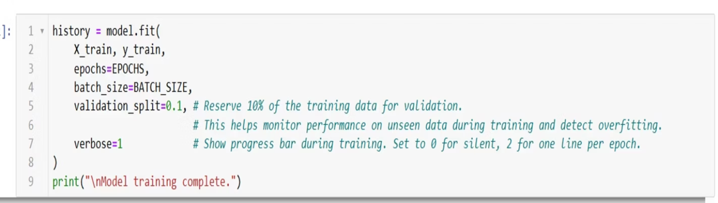
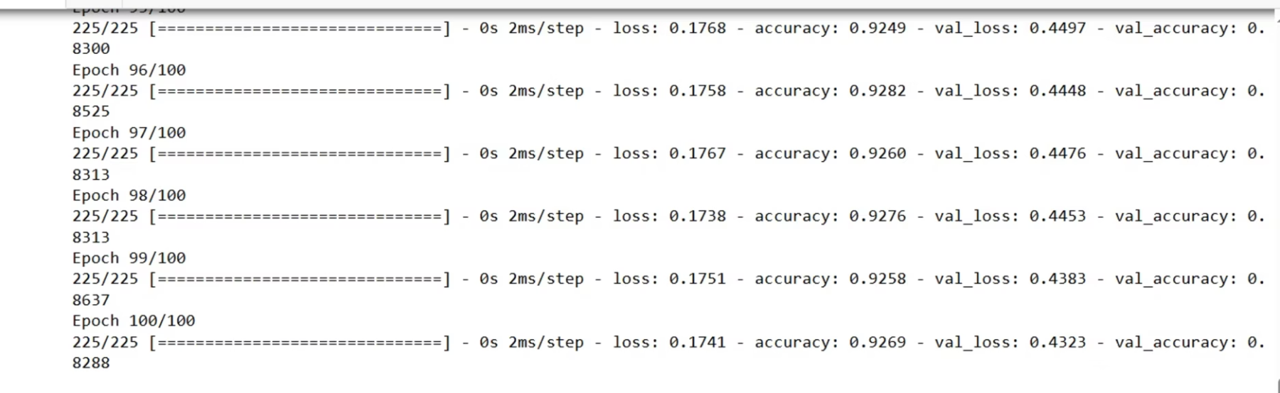
Fitting the model
• Train the data using model.fit. This method is used to train the artificial neural network model on the training data.
• The model.fit() function takes several parameters, including the training data (X_train and y_train), the number of epochs to train for, and the batch size.
• The number of epochs determines how many times the entire training dataset is passed through the neural network during training. Typically, you'll want to train for a large number of epochs to allow the model to fully learn the patterns in the data.
• The batch size determines how many samples are passed through the network at a time during each iteration of training. Smaller batch sizes can lead to more stable gradients and better generalization, but may take longer to train.
Model performance
After training the model, it reached an accuracy of 92% in 100 epochs with a batch size of 20.
The model.fit() function also returns a history object that contains information about the model's performance during training, such as the loss and accuracy at each epoch.
This information can be used to monitor the model's progress and determine when to stop training (e.g., when the validation accuracy stops improving).

Slide 19
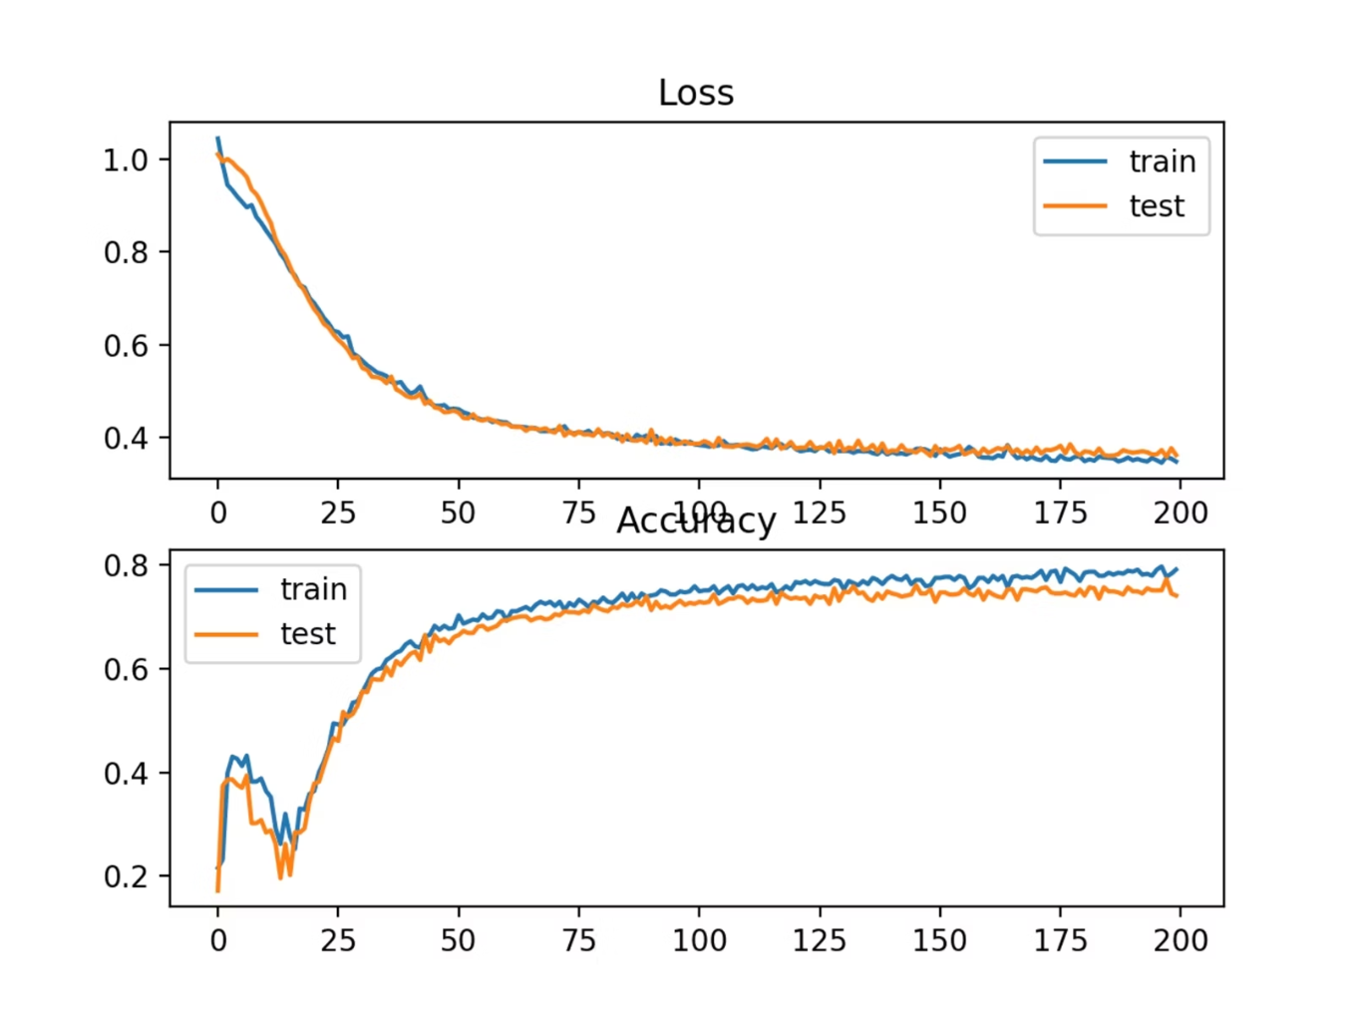
Model Accuracy and Loss Over Epochs
This graph shows the training and validation accuracy and loss of a machine learning model over the course of the training process, which is typically measured in epochs.
The blue line represents the training accuracy, which is how well the model is performing on the data it was trained on. The orange line represents the validation accuracy, which is how well the model is performing on data it has not been trained on.
The green line represents the training loss, which is a measure of how much the model's predictions differ from the true labels during training. The red line represents the validation loss, which is a measure of how much the model's predictions differ from the true labels on the validation data.
Ideally, we want to see the training and validation accuracy increasing over time, while the training and validation loss decrease. This indicates that the model is learning patterns in the data and generalizing well to new, unseen data. If the training accuracy keeps increasing but the validation accuracy plateaus or decreases, it may indicate that the model is overfitting to the training data.
Analyzing this graph can help us understand how the model is performing and make adjustments to the model architecture, hyperparameters, or training process to improve its performance.

Slide 20
Interpretation & Insights
•- Model achieved high training and validation accuracy
•- Tenure and age appear to be strongly correlated with churn
•- ReLU helps with non-linearity, Sigmoid outputs probabilities

Slide 21
Evaluation Metrics
•- Accuracy: Measured on validation/test data
•- Confusion Matrix (not shown here): Useful to calculate Precision, Recall, F1
•- ROC-AUC can be used for further performance insights

Slide 22
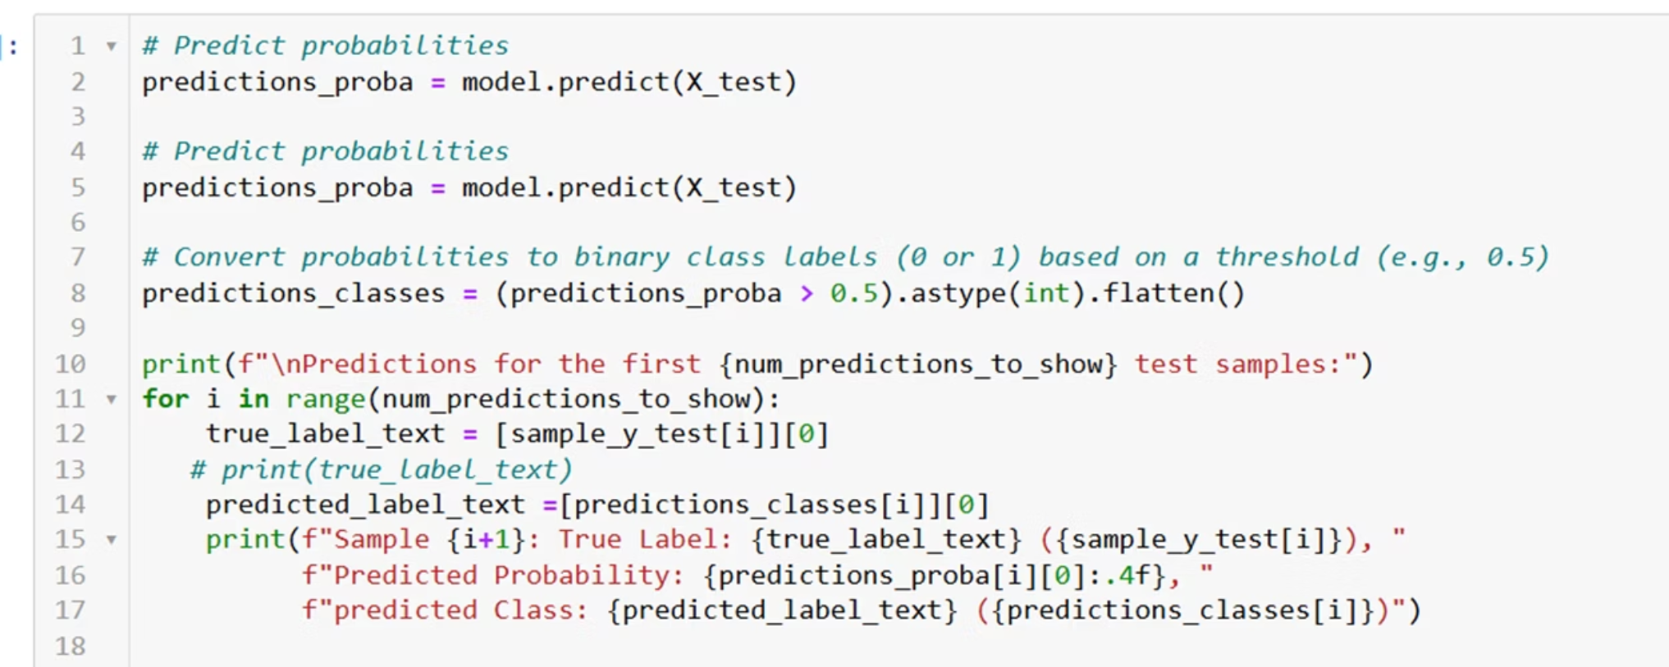
Model Prediction
After training the artificial neural network model, we can use the model.predict() function to make predictions on new, unseen data.
The model.predict() function takes the input data (X_test) and returns the predicted class labels or probabilities. If the model is a binary classifier, the output will be a single probability value between 0 and 1 for each sample, representing the likelihood of the sample belonging to the positive class.
We can then apply a decision threshold (typically 0.5) to convert the probabilities into binary class labels of 0 or 1.

Slide 23
Limitations & Future Work
•- Imbalanced dataset might affect precision/recall
•- Could use dropout layers to prevent overfitting
•- Hyperparameter tuning (grid/random search) can improve performance

Slide 24

Enhancing Model Performance
•- Implementing ensemble methods like Random Forest or Gradient Boosting can boost predictive accuracy
•- Exploring advanced activation functions such as Leaky ReLU or Swish for better model convergence
•- Utilizing transfer learning techniques from pre-trained models for feature extraction

Slide 25
Enhancing Model Performance
Hyperparameter Tuning
Dropout and Callbacks
To further improve the performance of the ANN model, we can tune the hyperparameters, which are the configuration settings that are not learned during the training process. Some key hyperparameters to tune include:
Dropout is a regularization technique used to prevent overfitting in neural networks. It randomly "drops out" a proportion of the neurons during training, forcing the remaining neurons to learn more robust features.
Number of hidden layers - Increasing the depth of the network can help capture more complex patterns, but too many layers can lead to overfitting.
Callbacks are functions that are called at certain points during the training process, such as at the end of each epoch. Useful callbacks include:
Number of neurons per layer - More neurons provide more modeling capacity, but too many can also cause overfitting.
EarlyStopping - Stops training if the validation metric does not improve for a specified number of epochs.
Learning rate - Controls the step size during gradient descent optimization. A higher rate can lead to faster convergence, but may overshoot the optimum.
ReduceLROnPlateau - Reduces the learning rate when the validation metric plateaus.
ModelCheckpoint - Saves the model weights when the validation metric improves.
Batch size - Determines how many samples are used in each training iteration. Larger batch sizes are more efficient but can miss some patterns.
Combining hyperparameter tuning, dropout, and callbacks can significantly boost the performance of the ANN model.
Regularization strength - Adding L1 or L2 regularization can help prevent overfitting by penalizing complex models.

Slide 26
References
The following references were used in the creation of this presentation:
Python :- https://github.com/ToshiMago/IIT_PG_BankCustomer_churn/blob/main/Bank_Customer_churn_tensor_flow.ipynb
Kaggle Dataset :- https://github.com/ToshiMago/IIT_PG_BankCustomer_churn/blob/main/Bank%20Customer%20Churn%20Prediction.csv
ANN overview and detailed explaination taken from various internet sources

Slide 27
Thank You

